Slide 1
LTSpice Introduction
Construct a circuit
Put down circuit elements and ground
Connect the elements and ground
Label nodes (to be helpful)
Write down SPICE directive
Run simulation
Operating point example

Slide 2
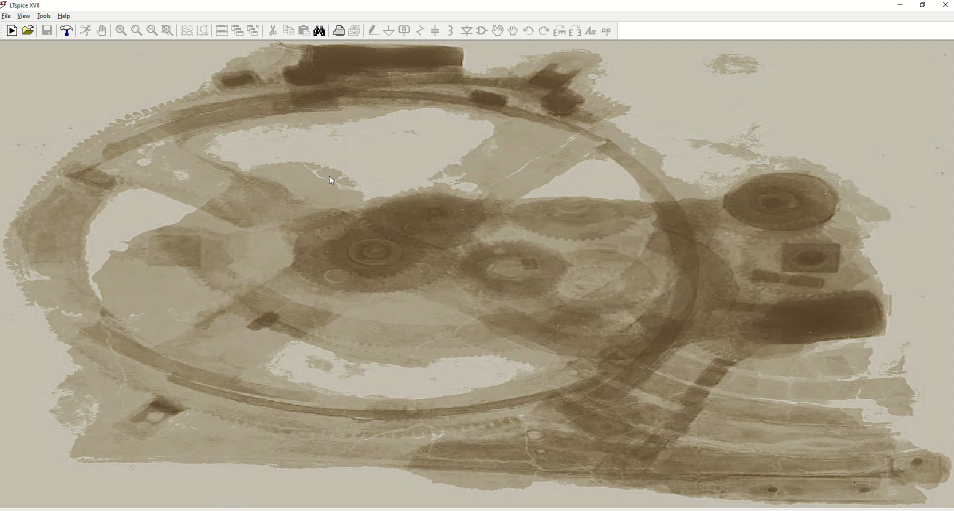
Construct a circuit: elements & ground

Slide 3
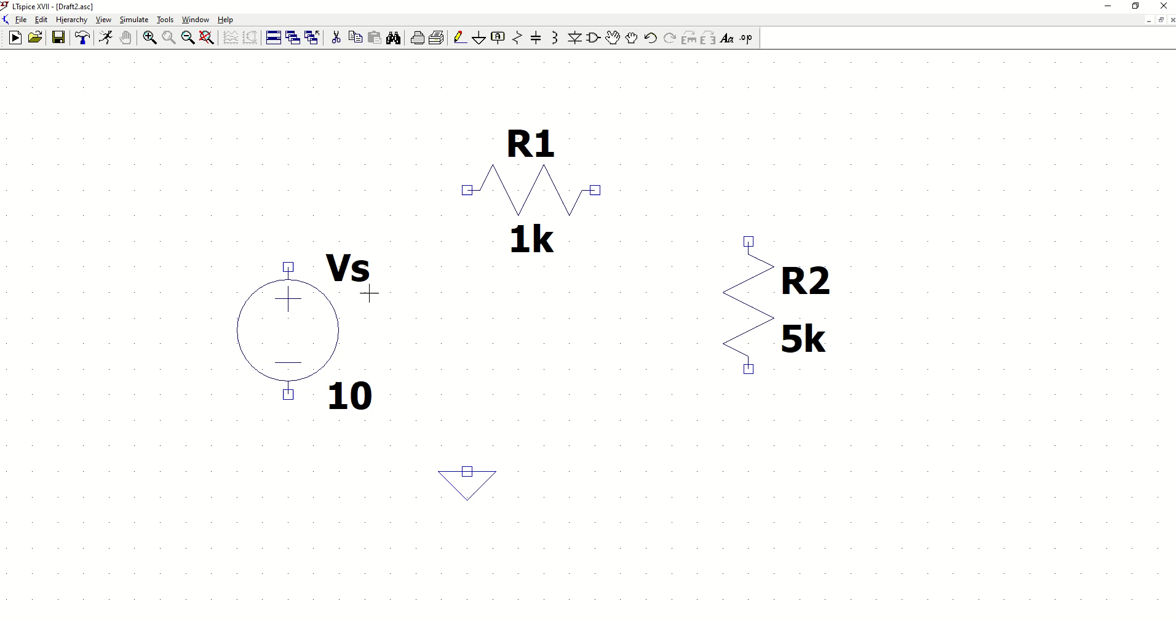
Connect the elements & ground

Slide 4
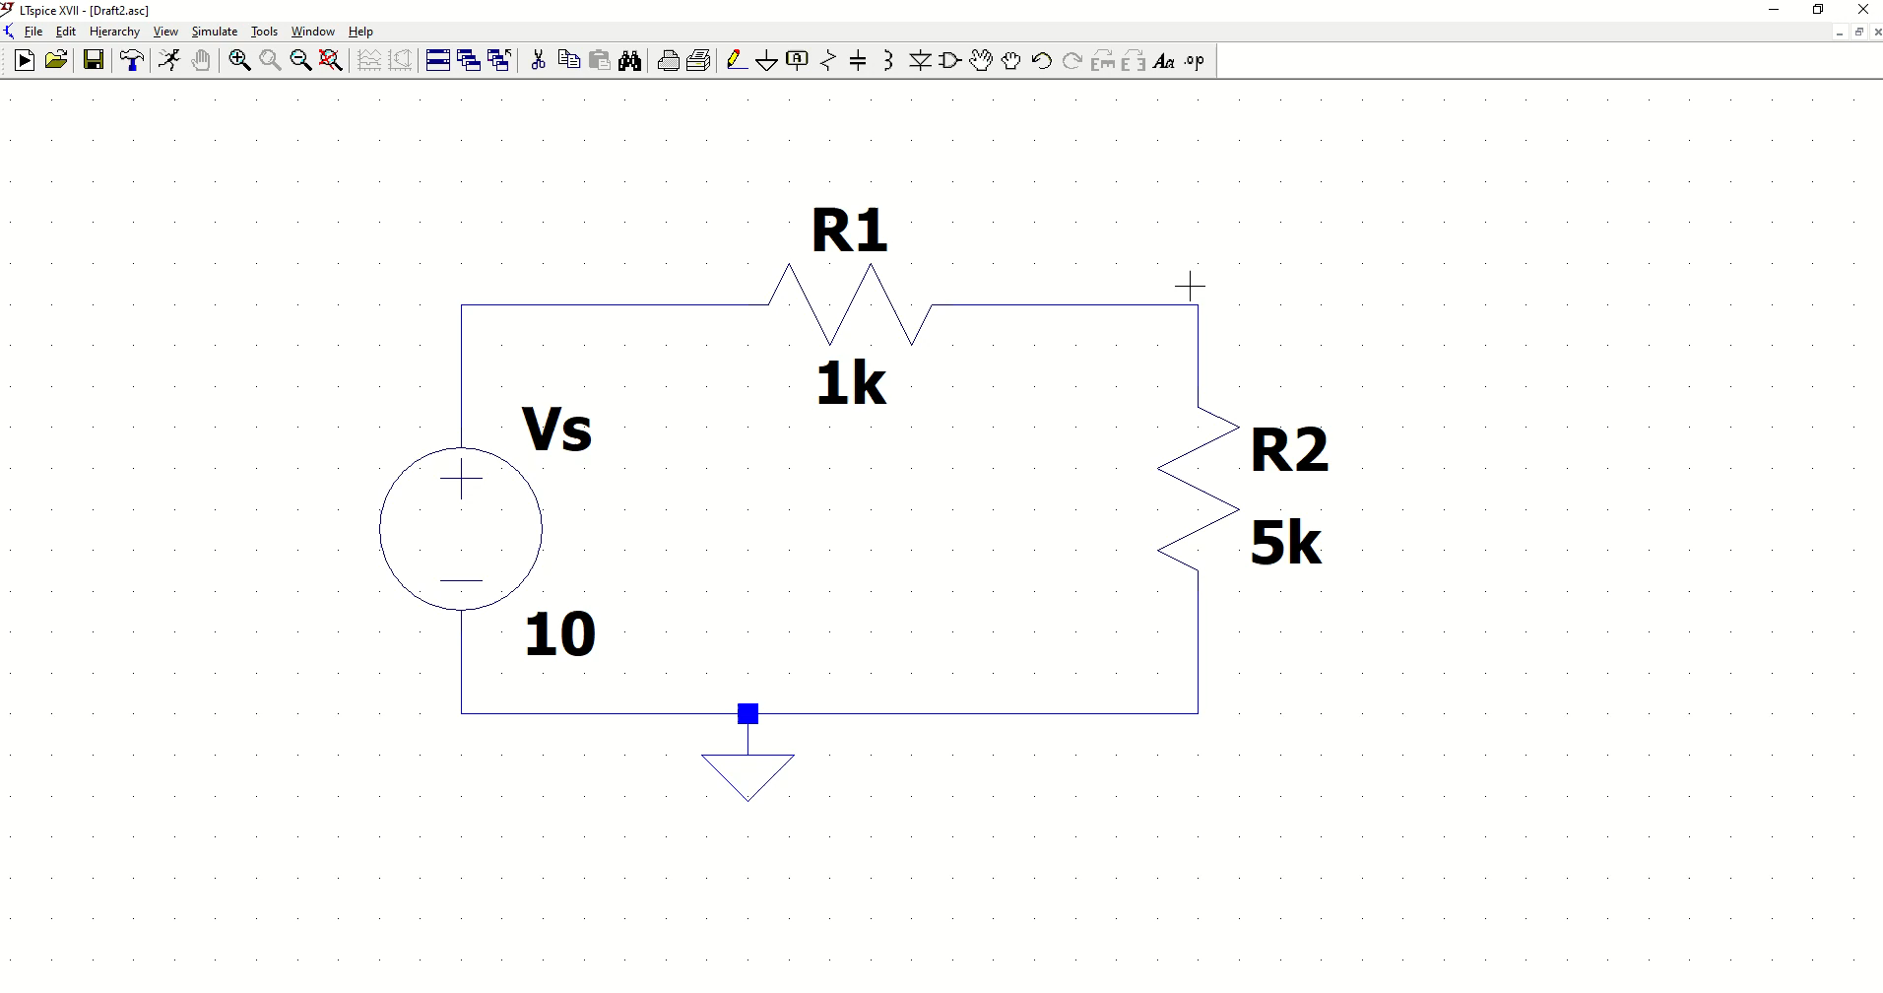
Label the nodes (to be helpful)

Slide 5
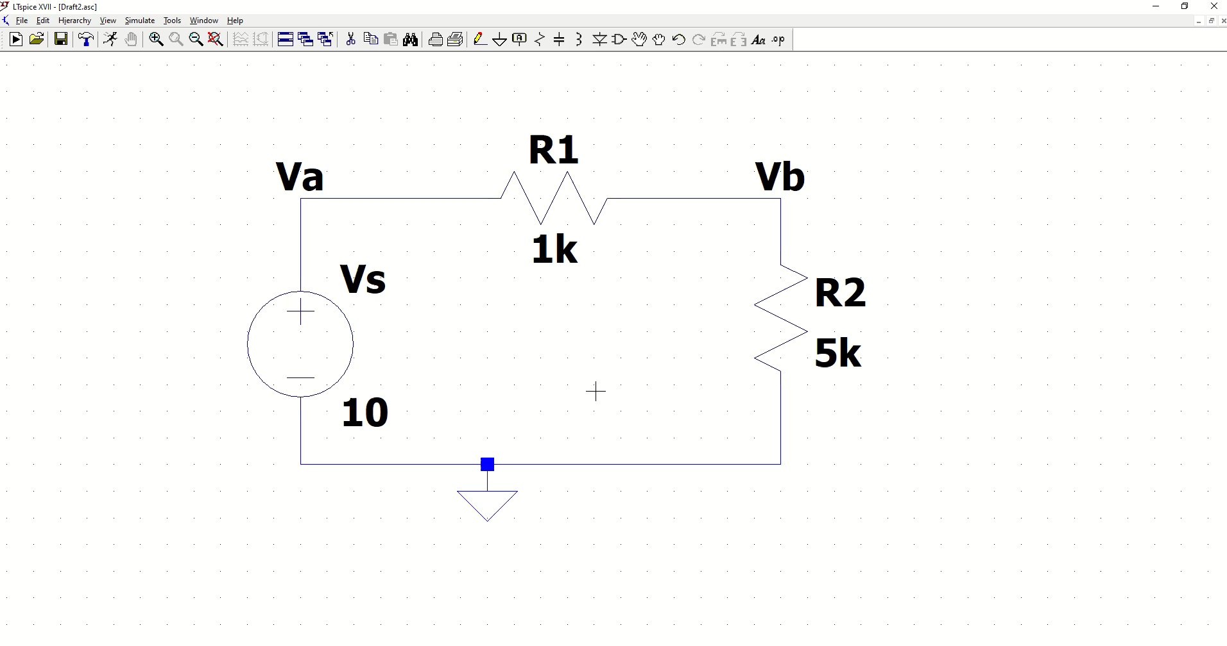
Write down SPICE directive

Slide 6
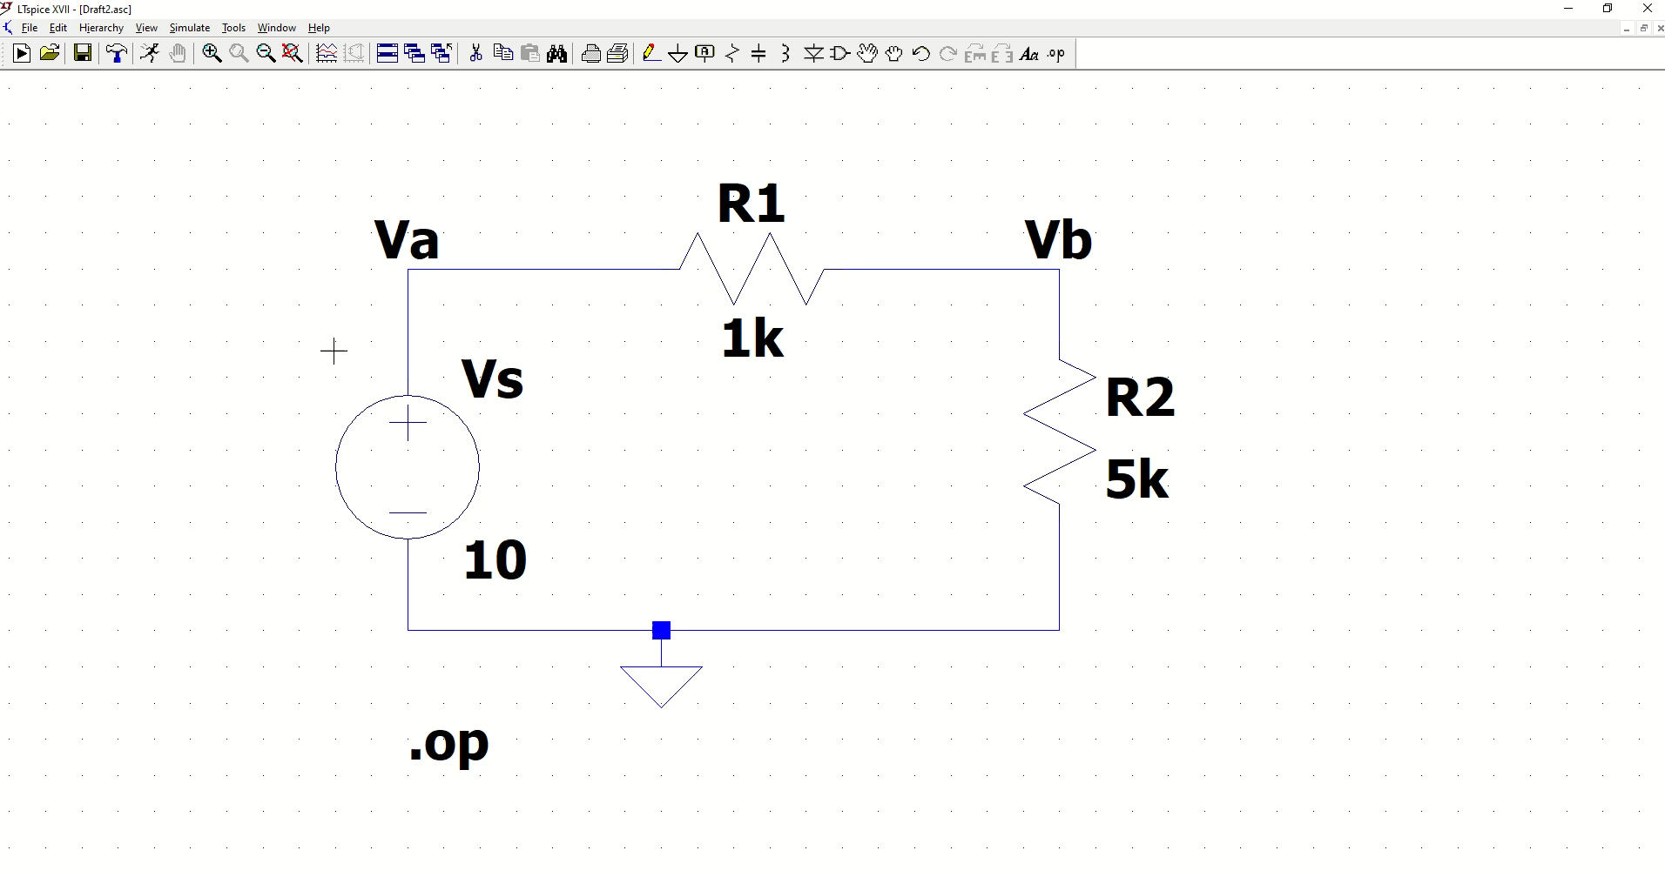
Run simulation: operating point example

Slide 7
Thank you
Now try making a circuit on your own.

